Slide 1
Customer Holiday Booking Prediction
Data Insights and Model Feasibility

Slide 2
Project Overview
Objective: Predict customer holiday bookings
Data: 50,000 records with 14 features
Approach: Data analysis, feature engineering, and model evaluation

Slide 3
Key Data Insights
Passenger Behavior: Average passengers per booking = 1.59
Booking Lead Time: 50% of bookings within 51 days
Stay Duration: Skewed data with an average of 23 days
Booking Preferences:
→ 67% prefer extra baggage
→ 29% prefer preferred seating
→ 42% opt for in-flight meals

Slide 4
Data Exploration Findings
Booking Trends:
-> Peak booking hours: 5 AM to 1 PM (highest at 9 AM)
-> Weekend bookings slightly higher
Route Preferences:
-> Popular route: AKLDEL (Auckland to Delhi)
Flight Duration Impact:
-> Shorter flights = Higher booking rates

Slide 5
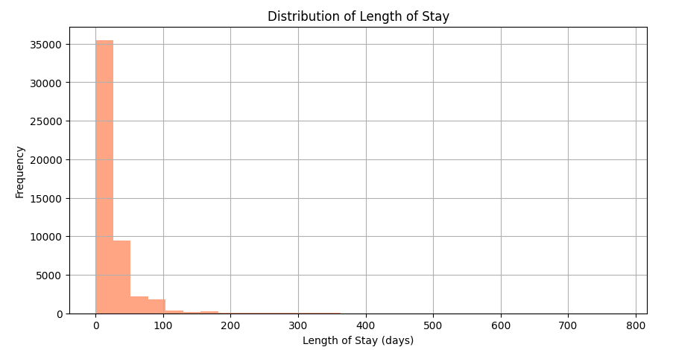
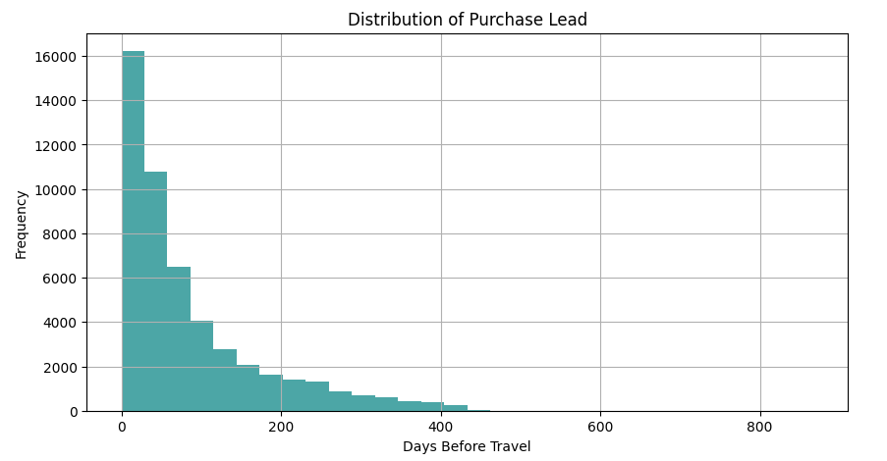

Slide 6
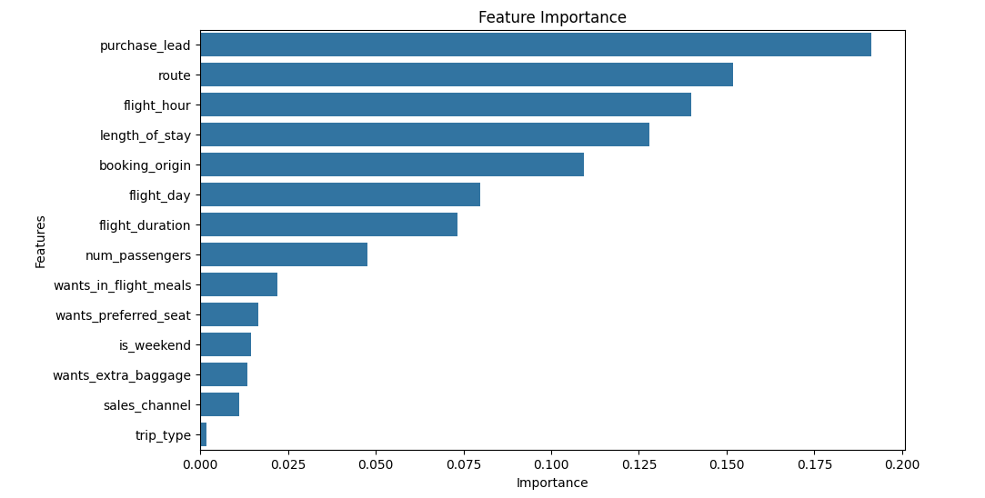
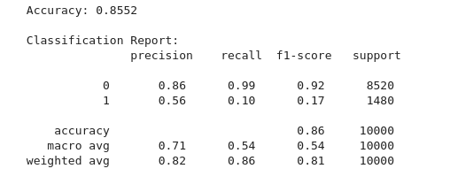

Slide 7
Model Insights
Algorithm Used: Random Forest
Performance Metrics:
-> Accuracy: 85.52%
-> Precision: 86%
-> Recall: 99%
Top Features Impacting Bookings:
-> Purchase Lead Time
-> Length of Stay
-> Extra Baggage Preference

Slide 8
Conclusion
# Key Takeaways:
Promising Predictive Potential:
-> The Random Forest model achieved an accuracy of 85.52%, with strong recall (99%), indicating the model is effective at identifying potential bookers.
-> Features like purchase lead time, length of stay, and baggage preference significantly impact booking behavior.
Challenges to Address:
-> Class imbalance (85% non-bookers) could impact the model’s generalization.
-> Data limitations, such as missing customer demographics, may restrict predictive capabilities.
# Final Thoughts:
-> Predicting customer holiday bookings is feasible with further refinements and data enrichment, leading to actionable insights for targeted marketing and better resource planning.

